Slide 1
Steps to Take
To Support a Culture of Care On-Campus
Adapted from JED Foundation
SUPPORT mental health and wellness
RECOGNIZE a student who is struggling
REACH OUT to a student who is struggling
CONNECT students to supports and resources

Slide 2
Resources
IMMEDIATE EMERGENCY ASSISTANCE
Call 911
DOSS: 603-646-3333 (Emergency)
CAMPUS RESOURCES
Counseling Center / On-Call Services: 603-646-9442
Dean On-Call: 603-646-4000 (Ask to Speak with Dean On-Call)
DOSS: 603-646-4000 (Non-Emergency)
College Chaplains: 603-646-3780
Student Wellness Center: 603-646-9414
Faculty / Employee Assistance Program (FEAP): 844-216-8308
Peer Support (through MHU)
Sexual Assault Peer Alliance (SAPA)
NATIONAL SUICIDE PREVENTION HOTLINES
National Suicide Prevention Hotline: Call 988 OR 800-273-TALK
Crisis Text Line: Text “COURAGE” to 741741

Slide 3
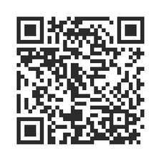
Want to Learn More?
Sign Up for the Campus Connect Suicide Prevention Training
Upcoming Trainings for Staff & Faculty (Fall 2022)
Wednesday, November 9, 1pm-3pm (In-Person)
Thursday, December 8, 10am-12pm (Zoom)
Sign Up (with Link or QR Code):
https://dartmouth.co1.qualtrics.com/jfe/form/SV_7Pq1SS0tBFYLzrU
If you are interested in your department receiving the Campus Connect Training, please email Dominique Walton (dominique.walton@dartmouth.edu to make this request.

